Slide 1
classes in classes, functions, and collections.
Week 6 | Lecture 1 (6.1.2)
While waiting for class to start:
Download and open the Jupyter Notebook (.ipynb) for Lecture 6.1.2
You may also use this lecture’s JupyterHub link instead (although opening it locally is encouraged).
Upcoming:
Reflection 6 released Friday @ 11 AM
Lab 5 due this Friday
Behrang’s Coffee Break / Office Hours Friday @ 1 PM
PRA (Lab) on Friday @ 2PM this week
Exam Review - When is your preference?

Slide 2



Exam: June 26, 2:00 PM Exam Centre (EX) 100

Slide 3

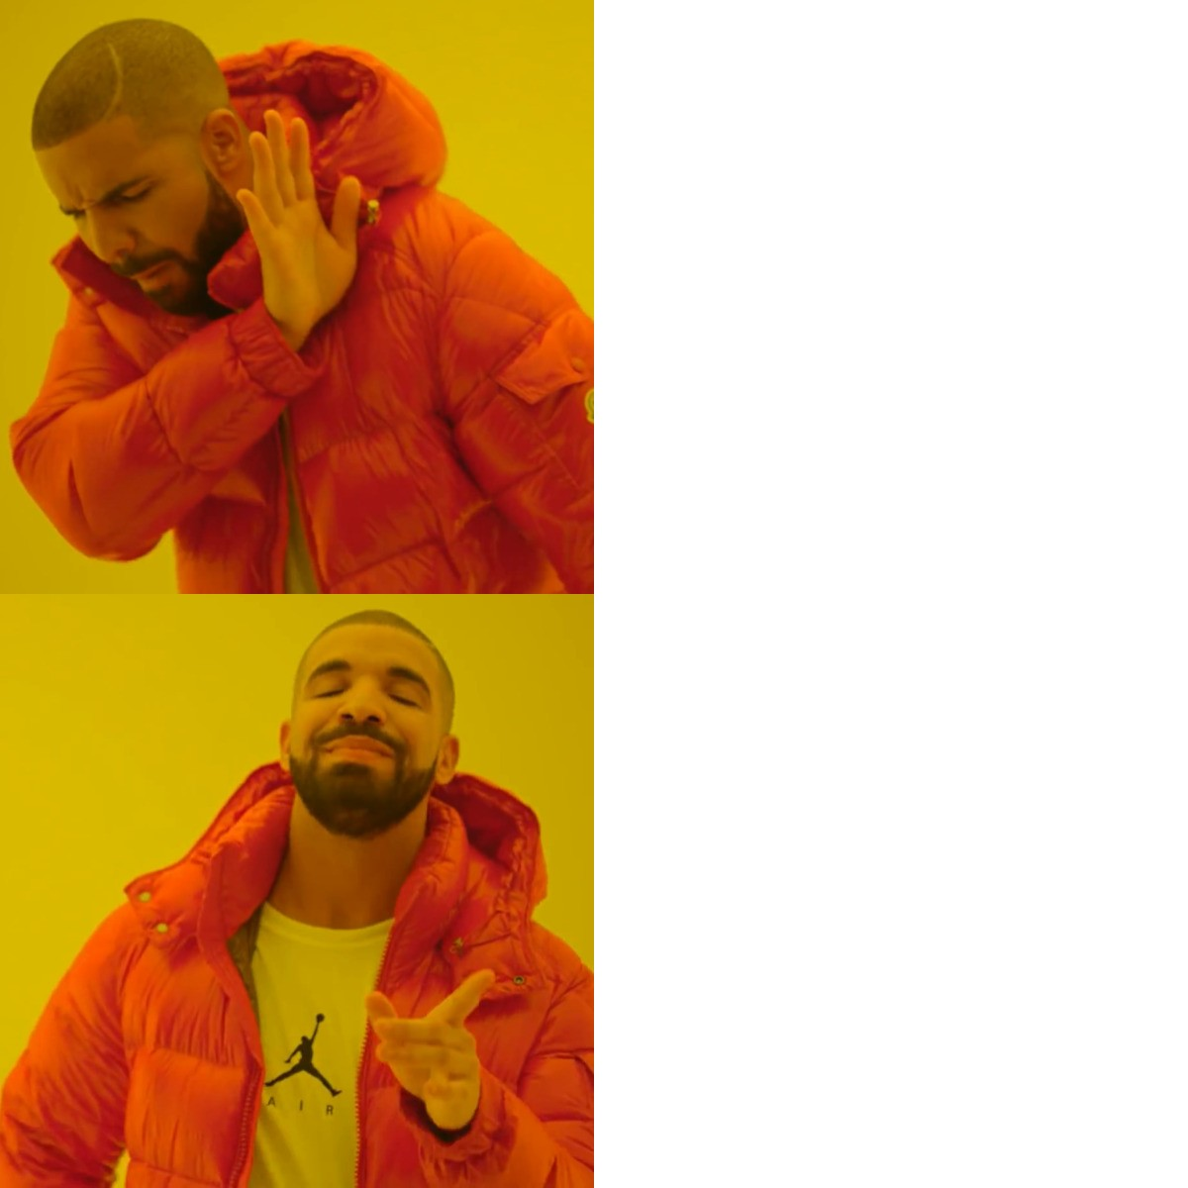
Coffee Break!
Extra help hours!
TIP FOR UNIVERSITY SUCCESS: Put in calendar, treat as a scheduled class, and bring one question you are confused about
Ben: Wednesday 1-3 PM
Behrang: Friday 11 AM -1 PM
Office Hours
Coffee Break

Slide 4
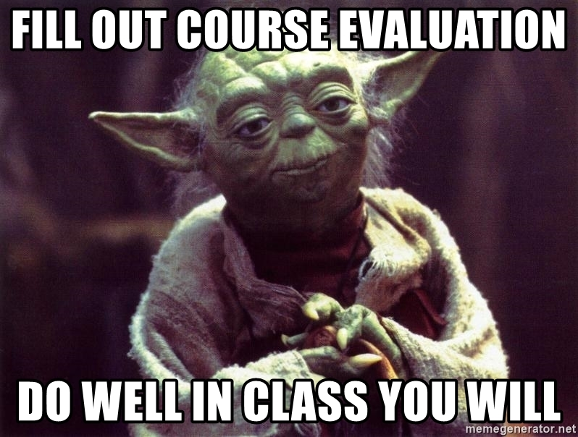
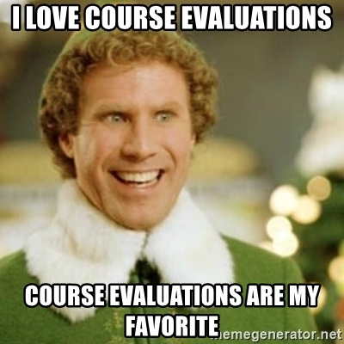
Course Evaluations
Extremely helpful! Every comment is read by your instructor and their department
You can help determine who teaches this course and how it’s taught in the future!
Please take the time to complete the course evaluation by June 20, 2022 (only takes 5 minutes)
Quercus ->Course Evals tab on left ->
https://q.utoronto.ca/courses/48756
Things we’ve changed from course evalutation feedback:
No pre-labs
Lecture schedule changes (while loops before for loops, OOP before files, removing linked lists & binary trees)
More fun design problems

Slide 5
OOP Recap
Is this an instance
of this class.
Everything in Python is an object.
>>> isinstance(4, object)
True
>>> isinstance(max, object)
True
>>> isinstance(“Hello”, object)
True

Slide 6
OOP Recap
Class
A class can be thought of as a template for the objects that are instances of it.
Attributes
Data
Methods
Functions

Slide 7

OOP Recap
Turtle
Instances (objects) of the Turtle class.
name
x location
y location
name: Susmit
x location: 134
y location: 45
name: Lucy
x location: 24
y location: 35
move up
move down
move left
move right
go to
name: Brian
x location: 92
y location: 62

Slide 8
OOP Recap
class Name:
def __init__(self, param1, param2, …):
self.param1 = param1
self.param2 = param2
…
body
def method1(self, parameters):
body
def method2(self, parameters):
body
def method3(self, parameters):
body
General form of a Class:
Class Name
CamelCase
CourseGrades
BankAccount
FlightStatus
XRayImage
Constructor
Methods

Slide 9
OOP Recap
Instantiate: Creating (constructing) an instance of a class.
alex = Turtle(0, 0)
This is the process of instantiating.

Slide 10
OOP Recap
Encapsulation
The core of object-oriented programming is the organization of the program by encapsulating related data and functions together in an object.
Encapsulation permits objects to operate completely independently of each other as discrete and self-contained bunch of data and code.
Class
Attributes
Methods

Slide 11
OOP Recap
self
Reference to the instance of the class.
class Turtle:
def __init__(self, x, y):
self.x = x
self.y = y
def up(self):
self.y += 1
def goto(self, x, y):
self.x = x
self.y = y
def get_position(self):
return self.x, self.y

Slide 12
OOP Recap
katia = Turtle(0, 0)
class Turtle:
def __init__(katia, x, y):
katia.x = x
katia.y = y
def up(katia):
katia.y += 1
def goto(katia, x, y):
katia.x = x
katia.y = y
def get_position(katia):
return katia.x, katia.y

Slide 13
OOP Recap
ben = Turtle(0, 0)
class Turtle:
def __init__(ben, x, y):
ben.x = x
ben.y = y
def up(ben):
ben.y += 1
def goto(ben, x, y):
ben.x = x
ben.y = y
def get_position(ben):
return ben.x, ben.y

Slide 14
OOP Recap
seb = Turtle(0, 0)
class Turtle:
def __init__(seb, x, y):
seb.x = x
seb.y = y
def up(seb):
seb.y += 1
def goto(seb, x, y):
seb.x = x
seb.y = y
def get_position(seb):
return seb.x, seb.y

Slide 15
OOP Recap
Because at the time of designing the class we don’t know what these instance names will be, we just chose one.
self
class Turtle:
def __init__(self, x, y):
self.x = x
self.y = y
def up(self):
self.y += 1
def goto(self, x, y):
self.x = x
self.y = y
def get_position(self):
return self.x, self.y

Slide 16
OOP Recap
Although you do not technically need to use the word self, it is widely adopted and is recommended.
this
instance
thing
self
class Turtle:
def __init__(self, x, y):
self.x = x
self.y = y
def up(self):
self.y += 1
def goto(self, x, y):
self.x = x
self.y = y
def get_position(self):
return self.x, self.y
Python Standard
(IDE Demo)

Slide 17
OOP Recap
def my_func():
print(“Hello”)
my_func
Accessing attributes (Data) and methods (Functions) is different.
This function has not been called.
ben = Turtle(0, 0)
ben.x
ben.up()
An Attribute is like a variable.
A Method is a function, and we call functions using parentheses.

Slide 18
OOP Recap
def my_func():
print(“Hello”)
my_func
Accessing attributes (Data) and methods (Functions) is different.
This function has not been called.
ben = Turtle(0, 0)
ben.x
ben.up()
Non-OOP
Non-OOP

Slide 19
OOP Recap
def my_func():
print(“Hello”)
my_func
Accessing attributes (Data) and methods (Functions) is different.
This function has not been called.
ben = Turtle(0, 0)
ben.x
ben.up()
OOP
OOP

Slide 20
OOP Recap
seb = Turtle(0, 0)
class Turtle:
def __init__(self, x, y):
self.x = x
self.y = y
def up(self):
self.y += 1
def goto(self, x, y):
self.x = x
self.y = y
def get_position(self):
return self.x, self.y
These parameters are passed to the constructor (the __init__ method).

Slide 21
OOP Recap
seb = Turtle()
class Turtle:
def __init__(self):
self.x = x
self.y = y
def up(self):
self.y += 1
def goto(self, x, y):
self.x = x
self.y = y
def get_position(self):
return self.x, self.y
Curved brackets are required to create an object.

Slide 22
Review Point Class
Point
Our Point class from last lecture:
Contain data about the location of a Point instance.
Be able to calculate the distance between the Point instance and another point.
Be able to calculate distance between the Point and the origin.
x
y
distance between points
distance from the origin
Add new method

Slide 23
Review Point Class
Our Point class from last lecture:
Contain data about the location of a Point instance.
Be able to calculate the distance between the Point instance and another point.
Be able to calculate distance between the Point and the origin.
Open your notebook
Click Link:
1. Point Class

Slide 24
Methods and self
Inside Class Definition
Outside Class Definition
class Turtle:
def __init__(self, x, y):
self.x = x
self.y = y
def goto(self, x, y):
body
self.print_location()
def print_location(self):
body
alex = Turtle(10, 12)
alex.print_location()
The instance variable name refers to the instance outside the class definition.
self refers to the instance inside the class definition.

Slide 25
Methods and self
Inside Class Definition
Outside Class Definition
class Turtle:
def __init__(self, x, y):
self.x = x
self.y = y
def goto(self, x, y):
body
self.print_location()
def print_location(self):
body
alex = Turtle(10, 12)
alex.print_location()
When defining a method, the first parameter refers to the instance being manipulated (self).

Slide 26
Methods and self
Inside Class Definition
Outside Class Definition
class Turtle:
def __init__(x, y):
self.x = x
self.y = y
def goto(x, y):
body
self.print_location()
def print_location():
print(self.x, self.y)
alex = Turtle(10, 12)
alex.print_location()
Why do we always need to pass in self as the first parameter of a method?
Python assumes you need to access data and/or functions of the object.

Slide 27
Methods and self
Inside Class Definition
Outside Class Definition
class Turtle:
def __init__(x, y):
self.x = x
self.y = y
def goto(x, y):
body
self.print_location()
def print_location():
print(self.x, self.y)
alex = Turtle(10, 12)
alex.print_location()
A common error is to omit the self argument as the first parameter of a method definition.

Slide 28
Methods and self
Inside Class Definition
TypeError:
print_location() takes 0 positional arguments but 1 was given.
A method call automatically inserts an instance reference as the first argument.
Outside Class Definition
class Turtle:
def __init__(x, y):
self.x = x
self.y = y
def goto(x, y):
body
self.print_location()
def print_location():
print(self.x, self.y)
alex = Turtle(10, 12)
alex.print_location()
The error only occurs when you call the function.
Defining the methods without self will not cause an error.

Slide 29
Methods and self
Inside Class Definition
TypeError:
print_location() takes 0 positional arguments but 1 was given.
A method call automatically inserts an instance reference as the first argument.
Outside Class Definition
class Turtle:
def __init__(x, y):
self.x = x
self.y = y
def goto(self, x, y):
body
self.print_location()
def print_location(self):
body
alex = Turtle(10, 12)
alex.print_location()
Python does this for us.
The error only occurs when you call the function.
Defining the methods without self will not cause an error.

Slide 30
Calling Methods
There are two ways to call methods.
Method 1
One way is to access the method through the class name and pass in the object.
Class.method(instance_of_class)
Method 2
The other is to use object-oriented syntax.
instance_of_class.method()
Open your notebook
Click Link:
2. Calling Methods

Slide 31
Objects and Functions
Point
Functions and methods can return instances.
For example, given two Point objects, what if you want to create a point halfway in between?
x
y
distance between points
distance from the origin
midpoint between points
def calc_midpoint(self, point):
body
return Point(x, y)
Add new method

Slide 32
Objects and Functions
Functions and methods can return instances.
For example, given two Point objects, what if you want to create a point halfway in between?
Open your notebook
Click Link:
3. Add Midpoint Method to Point Class
def calc_midpoint(self, point):
body
return Point(x, y)

Slide 33
Variable Declarations Are Optional
While we can assign each point to a variable, is not necessary.
p1 = Point(3, 4)
p2 = Point(5, 12)
p3 = p1.midpoint(p2)
Here is an alternative that uses no explicit variables.
p3 = Point(3, 4).halfway(Point(5, 12))
Open your notebook
Click Link:
4. Variable Declarations Are Optional
Instance of Point
Instance of Point
Instance of Point

Slide 34
Objects as Data Attributes of Classes
Objects are programmer-created data types that can be used just like other data types.
In particular, the data in an object can be in the form of instances of other classes.
Point(x2, y2)
class Square:
def __init__(self, x1, x2, y1, y2):
self.lower_left = Point(x1, y1)
self.upper_right = Point(x2, y2)
Class Square
Point(x1, y1)

Slide 35
Objects as Data Attributes
Square
Create a Square class and use Point instances and attributes.
lower_left
upper_right
Point(x2, y2)
calculate area
calculate centre
Class Square
Point(x1, y1)

Slide 36
Objects as Data Attributes of Classes
Create a Square class and use Point instances and attributes.
Open your notebook
Click Link:
5. Objects as Data Attributes of Classes
Point(x2, y2)
Class Square
Point(x1, y1)

Slide 37
Objects In Collections
Of course, you can put objects in Python collections like lists, tuples, etc.
Open your notebook
Click Link:
6. Objects In Collections

Slide 38
Printing Attribute Information
It would be nice to not have to write a print statement each time we want to display some attribute information.
p = Point(3, 4)
print(p.x, p.y)
Is there some way we could encapsulate this process?
It would be better if we could have a method take care of it.
Open your notebook
Click Link:
7. Printing Attribute Information

Slide 39
Patient Class
What if you are writing a medical application that needs to keep track of patients and their data.
Let’s create a PatientData class.
Attributes
height_cm
weight_kg
Methods
print_data()
Open your notebook
Click Link:
8. Patient Class

Slide 40
classes in classes, functions, and collections.
Week 6 | Lecture 1 (6.1.2)

